Slide 1
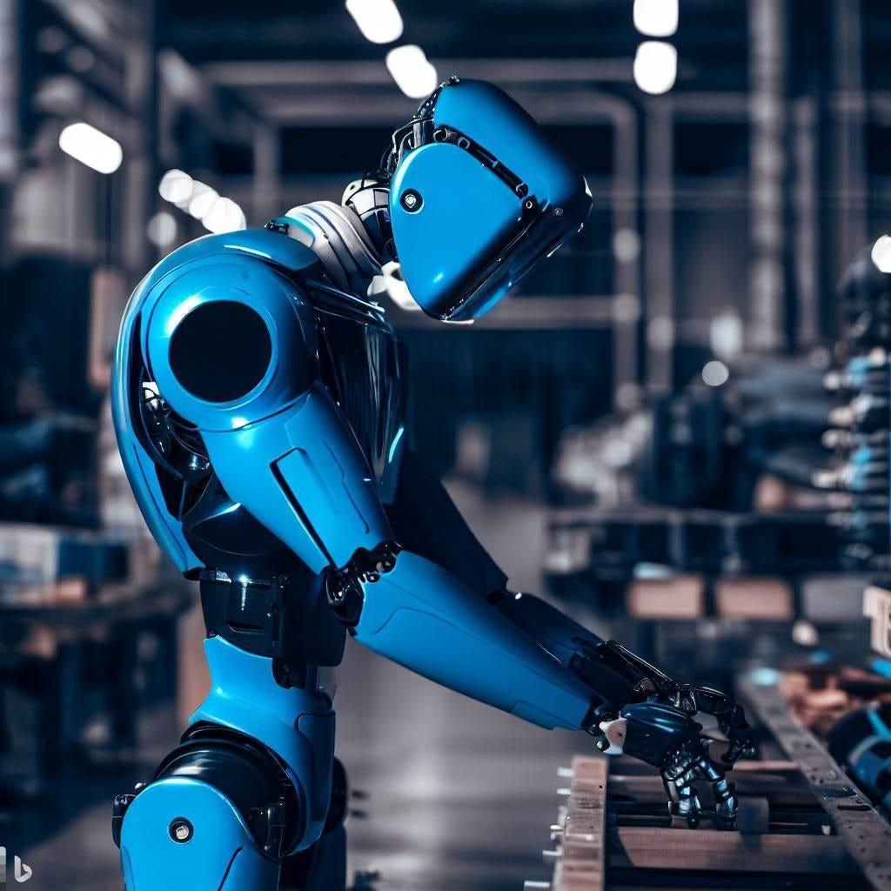
Introduction to Robotic Systems
NAME : HITENDRA SISODIA
SAP ID : 500091910
ROLL NO : R2142210352
BRANCH : CCVT NON HONS
GUIDED BY : MUKUL GUPTA

Slide 2

Introduction to Robotic Systems
Made By: Hitendra Sisodia​

Slide 3
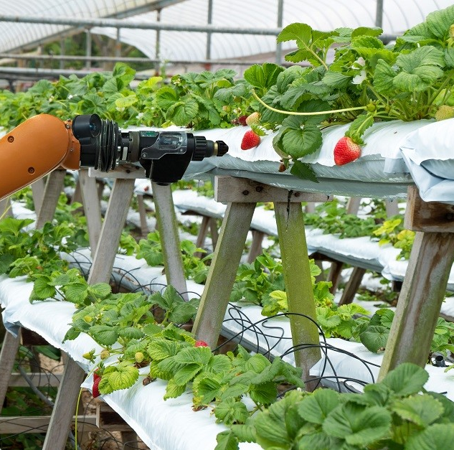
Development of an AI-based Robotic System for Precision Farming: An Agricultural Automation
AI-based robotic system for precision farming utilizes AI
Robotics technology to automate farming processes and optimize crop yields.
The system is versatile, adaptable, and designed to work autonomously with minimal human intervention.
It is cost-effective, integrates with existing infrastructure, and environmentally friendly.

Slide 4
Agenda
1
2
3
4
5
Introduction
Objective
Methodology
Working
Results and Conclusion

Slide 5
Introduction
Agriculture is a critical sector that plays a vital role in the global economy.
However, it is often faced with challenges such as climate change, limited resources, and labor shortages.
Therefore, it is essential to improve the agricultural process to ensure sustainability and profitability.

Slide 6





Objective
To create a system that can perform precision tasks such as seeding, planting, and harvesting with high accuracy and efficiency.
To use precision agriculture techniques to optimize resource utilization and reduce waste.
To reduce labor costs and increase productivity, ensuring profitability for farmers.
To contribute to sustainable food production, ensuring food security for future generations.
Providing assistance when required

Slide 7
Working
The first step in developing an AI-based robotic system for precision farming is to identify the needs and requirements of the agricultural industry.
The system should be designed to be versatile and adaptable to different types of crops and terrain, with sensors and cameras capable of detecting and analyzing different types of data, such as soil moisture, temperature, and plant growth.
The system should incorporate machine learning algorithms to process the data collected by the sensors and cameras, and to make decisions about optimal planting, harvesting, and irrigation techniques.

Slide 8
ML Model For Crop Prediction
Here's a simplified example of machine learning code for an agriculture robot using Python and the scikit-learn library.
This code demonstrates how to train a classifier to identify different types of crops based on their features.
Model Type: Random Forest Classifier
The machine learning model used in the code is a Random Forest Classifier, which is an ensemble learning method that combines multiple decision trees to make predictions. It is a popular choice for classification tasks due to its ability to handle complex datasets and provide good generalization performance.

Slide 9
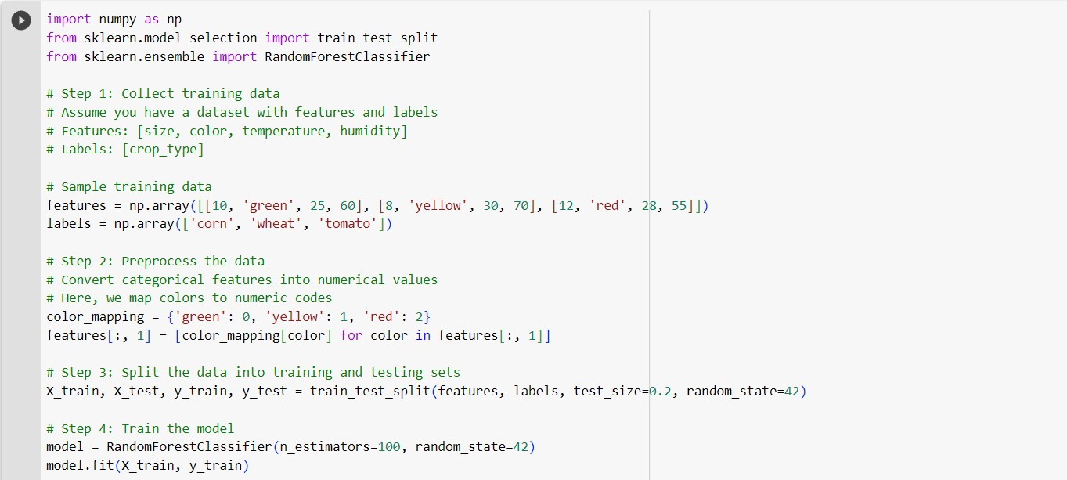
Machine Learning Model

Slide 10
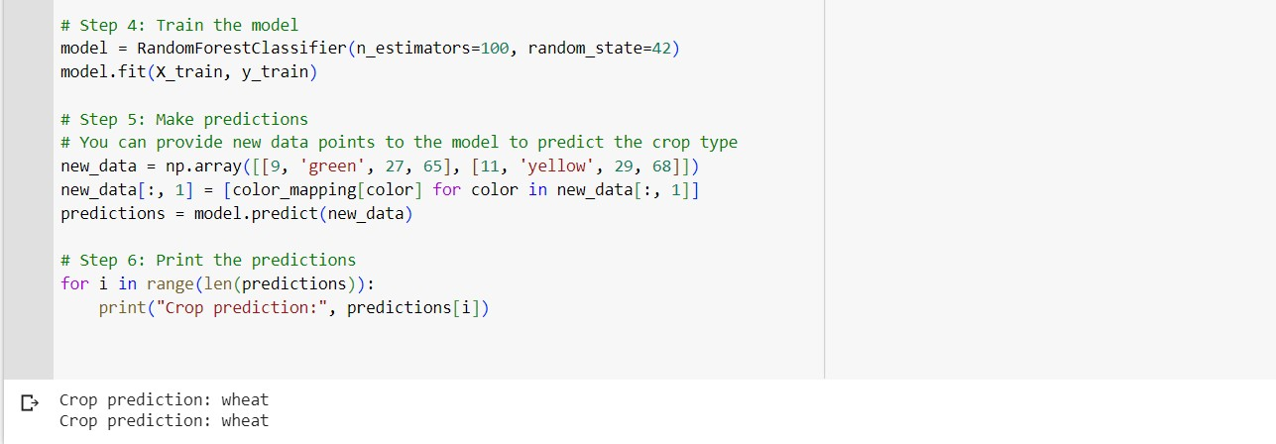
Machine Learning Model

Slide 11
ML Model For Crop Prediction
Features:
The model takes several features as input to predict the crop type. In the example code, the features used are:
Size: The size of the crop in some unit of measurement (e.g., centimeters).
Color: The color of the crop represented as a categorical variable (e.g., 'green', 'yellow', 'red').
Temperature: The temperature in degrees Celsius at which the crop is grown.
Humidity: The relative humidity percentage in the environment where the crop is grown.

Slide 12
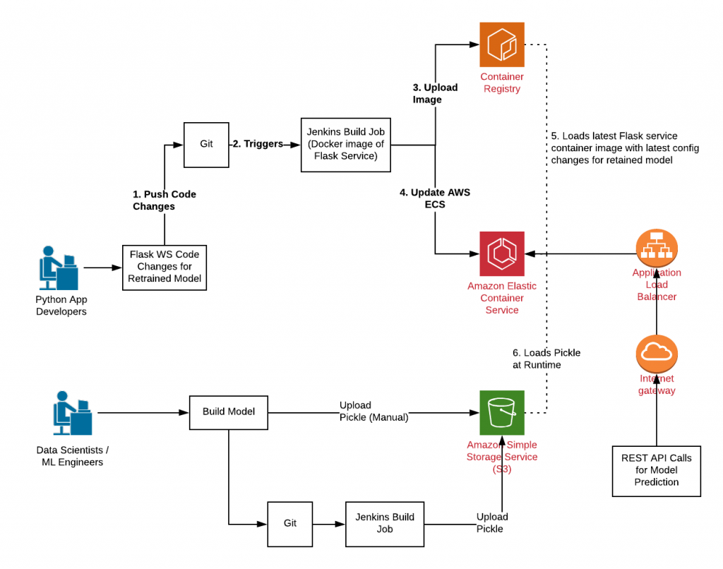
Deploy ML Model TO Cloud
1) Save the trained model
2) Set up cloud environment
3) Upload the model
4) Create an API endpoint
5) Expose the API
6) Test the deployment
7) Scale and monitor

Slide 13
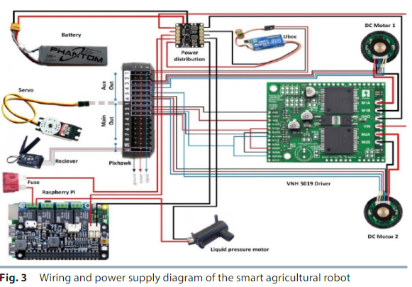
Circuit Diagram
The first step in designing the wiring and power supply diagram for a smart agriculture circuit is to identify the components that will be used, such as sensors, actuators, and microcontrollers.
The wiring diagram should be designed to be scalable, with the ability to add or remove components as needed without requiring major modifications to the wiring or power supply.
The wiring diagram should be designed to facilitate troubleshooting and repair.

Slide 14
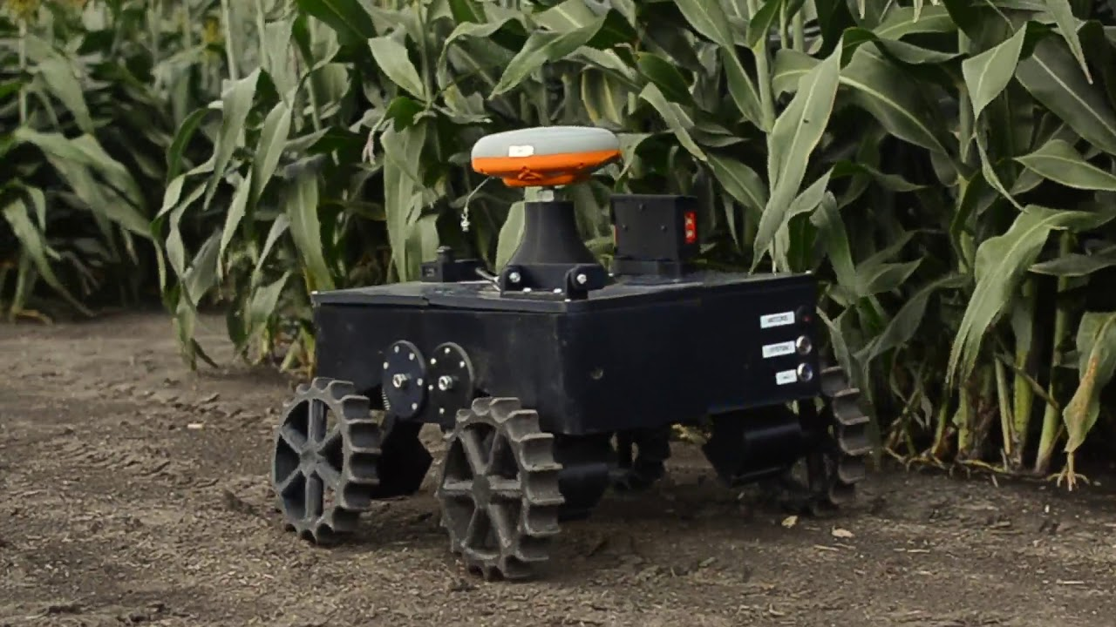
Working
The robotic system should be designed to work autonomously, with minimal human intervention, using GPS and other technologies to navigate the fields and carry out tasks.
The system should be designed to be cost-effective, with low maintenance and repair costs, and with the ability to integrate with existing farm equipment and infrastructure.

Slide 15
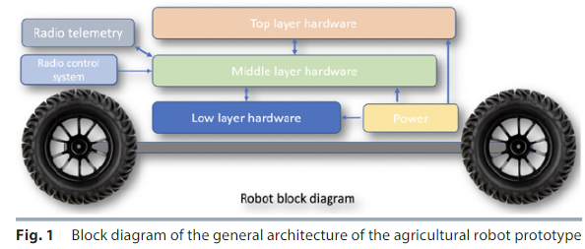
Working
The system should be designed to be versatile and adaptable to different types of crops and terrain, with sensors and cameras capable of detecting and analyzing different types of data.
The system should incorporate machine learning algorithms to process the data collected by the sensors and cameras, and to make decisions about optimal planting, harvesting, and irrigation techniques.

Slide 16
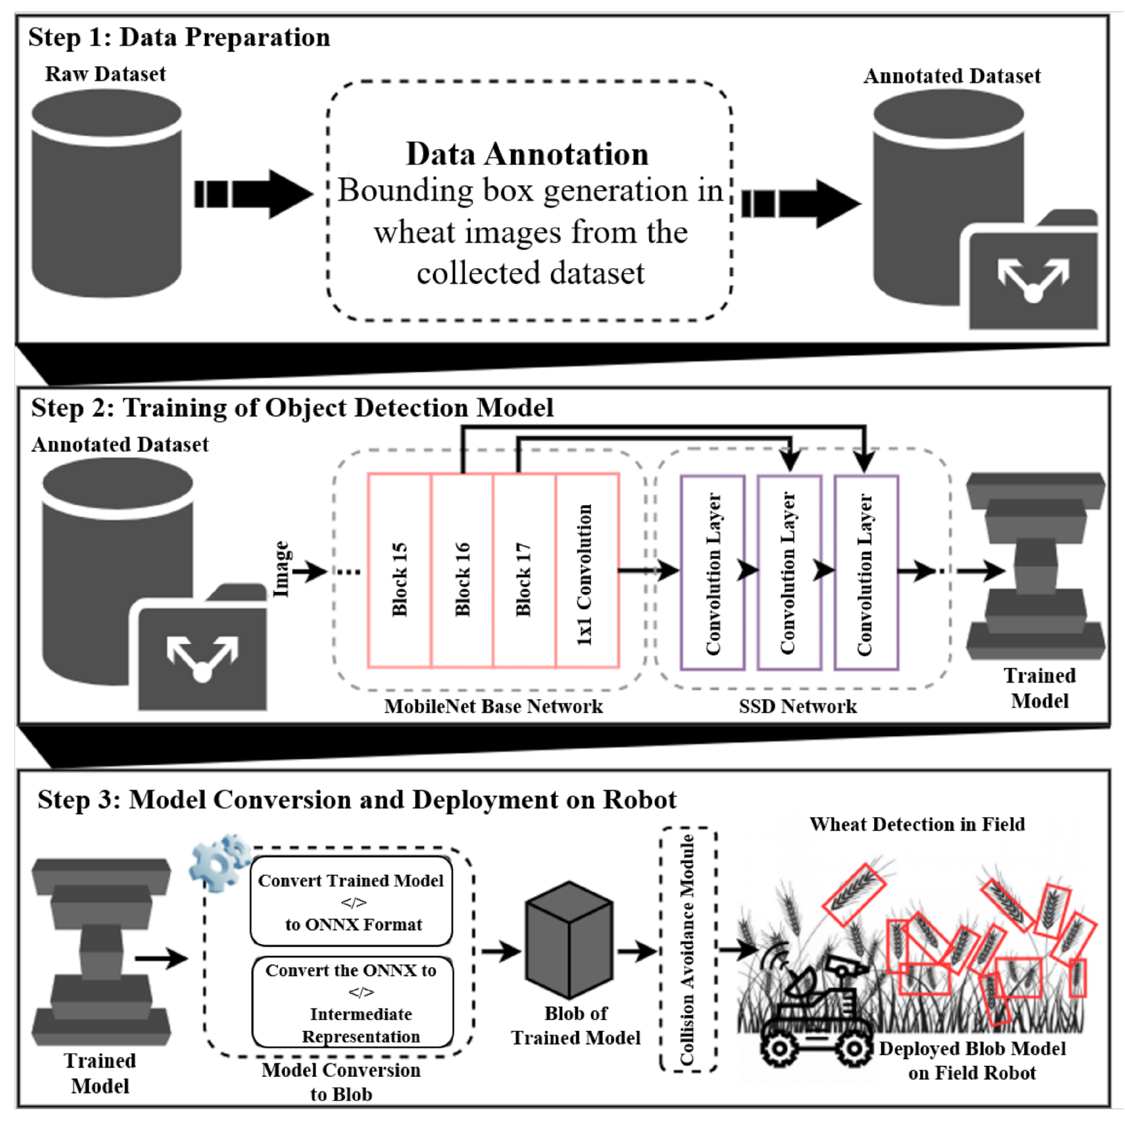
Working
Data Preparation:
Acquire or collect a dataset of images or videos relevant to precision farming, containing various objects of interest (e.g., crops, weeds, pests, machinery).
Annotate the dataset by labeling the objects of interest, specifying their bounding boxes or segmentation masks.
Split the dataset into training, validation, and testing sets. The training set will be used to train the model, the validation set for fine-tuning and hyperparameter tuning, and the testing set for evaluating the final model's performance.

Slide 17
Working
Training of Object Detection Model:
Choose an appropriate object detection model architecture such as YOLO (You Only Look Once), SSD (Single Shot MultiBox Detector), or Faster R-CNN (Region-based Convolutional Neural Networks).
Initialize the chosen model with pre-trained weights (e.g., on ImageNet) to leverage learned features.
Fine-tune the model on the annotated training dataset, optimizing it to detect and classify objects relevant to precision farming.
Utilize techniques like data augmentation (e.g., random scaling, rotations, flips) to increase the diversity of the training data and improve model generalization.
Monitor the model's performance on the validation set during training, adjusting hyperparameters (e.g., learning rate, batch size) as needed.
Repeat the training process until satisfactory performance is achieved.

Slide 18
Working
Model Conversion and Deployment on Road:
Once the object detection model is trained, convert it into a format suitable for deployment on the target hardware or platform.
Common conversion steps involve optimizing the model's size, reducing its computational complexity, and converting it to a format compatible with the deployment environment.
Ensure that the converted model retains its accuracy and performance metrics after conversion.
Integrate the converted model into the robotic system designed for precision farming.
Deploy the model on the onboard computer or edge device of the robotic system, depending on its computational requirements.
Implement the necessary software and hardware components to enable real-time inference of the object detection model.
Connect the robotic system's sensors (e.g., cameras, LiDAR) to the deployed model for input data acquisition.
Execute the object detection model to detect and classify objects of interest (e.g., crops, weeds, pests) in the robotic system's surroundings.
Utilize the detected information for various applications such as crop monitoring, weed detection, pest identification, or autonomous navigation within the precision farming context.

Slide 19
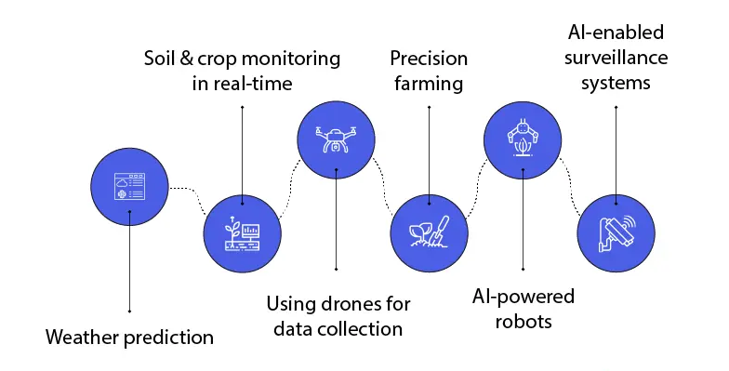
Design
The robotic system should be designed to work autonomously, with minimal human intervention, using GPS and other technologies to navigate the fields and carry out tasks.
The system should be designed to be cost-effective, with low maintenance and repair costs, and with the ability to integrate with existing farm equipment and infrastructure.

Slide 20
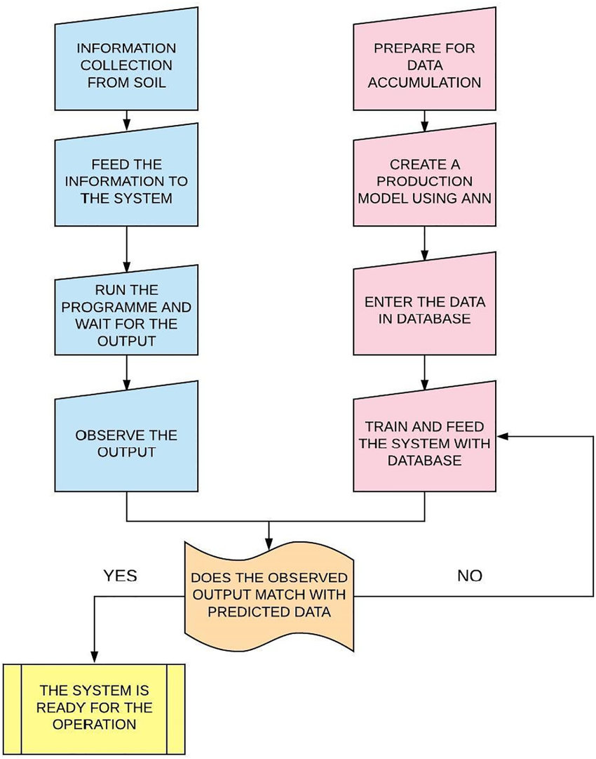
Flowchart
Data Acquisition:
Collect sensor data from various sources such as cameras, LiDAR, or other relevant sensors mounted on the robotic system. Acquire additional data sources like weather information, satellite imagery, or soil data if required for analysis and decision-making.
Data Preprocessing:
Clean and preprocess the acquired sensor data to remove noise, outliers, or inconsistencies. Perform data normalization or scaling to ensure compatibility and consistency across different data sources.
Object Detection and Classification:
Utilize an object detection model trained on annotated data to detect and classify objects of interest in the environment, such as crops, weeds, pests, or machinery. Apply the trained model to the preprocessed sensor data to identify and locate the relevant objects.
Data Analysis and Decision Making:
Process the detected object information along with other acquired data (e.g., weather, soil conditions) to derive insights and make informed decisions. Analyze crop health, identify weed-infested areas, detect pest presence, or assess overall field conditions.

Slide 21
Flowchart
Action Planning:
Based on the analysis results and predefined rules or algorithms, generate actionable plans or recommendations for the robotic system. Determine tasks like targeted spraying of pesticides, selective weed removal, or monitoring specific crop areas for further inspection.
Robotic System Control:
Translate the generated plans or recommendations into control commands for the robotic system. Coordinate the movements and actions of the robotic system to execute the desired tasks efficiently and accurately.
Feedback and Monitoring:
Continuously monitor the robotic system's performance and its impact on the farm's operations. Collect feedback data from sensors and monitoring devices to evaluate the effectiveness of the implemented actions.
Iterative Process:
Repeat the data acquisition, preprocessing, analysis, and decision-making steps periodically or in real-time to adapt to changing farm conditions.

Slide 22
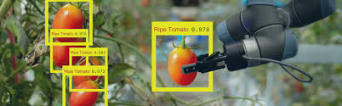
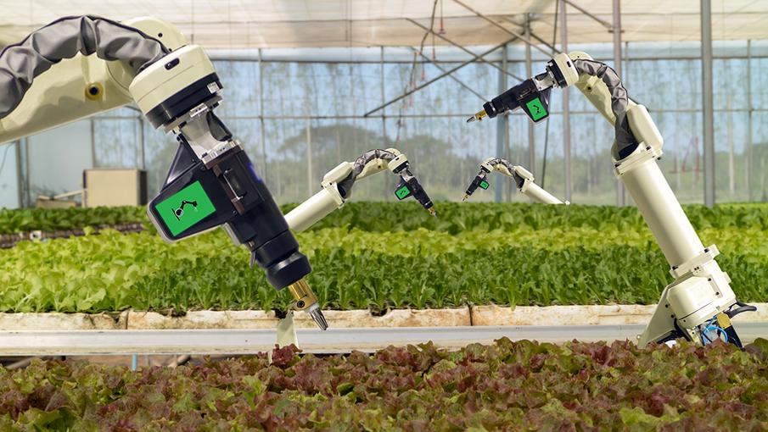
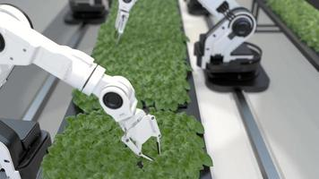
Robot Arms

Slide 23


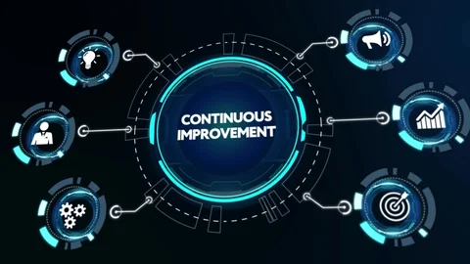
Methodology​
Deployment: We will deploy the developed system on a farm and monitor its performance to ensure its effectiveness in optimizing the farming process.
Data Collection and Analysis: Collect data from the system's sensors, cameras, and other components.
Continuous Improvement: Continuously monitor and evaluate the system's performance.

Slide 24
Methodology​
Methodology​ 1
Methodology​ 2
Methodology​ 3
Research and Analysis: We will conduct a thorough review of the existing literature and analyze the data to identify the challenges faced by the agricultural sector.
Design and Development: We will design and develop an AI-based robotic system for precision farming that utilizes advanced technologies such as computer vision, machine learning, and robotics.
Testing and Validation: We will test and validate the developed system in a real-world environment to ensure its accuracy and efficiency.

Slide 25
Background
Agriculture is a critical sector that plays a vital role in the global economy.
The sector faces several challenges such as labor shortages, limited resources, and climate change.
The use of AI and robotics in agriculture has the potential to revolutionize the sector by increasing efficiency, productivity, and sustainability.
Our project aims to develop an AI-based robotic system for precision farming that utilizes advanced technologies to optimize the farming process and contribute to sustainable food production.

Slide 26
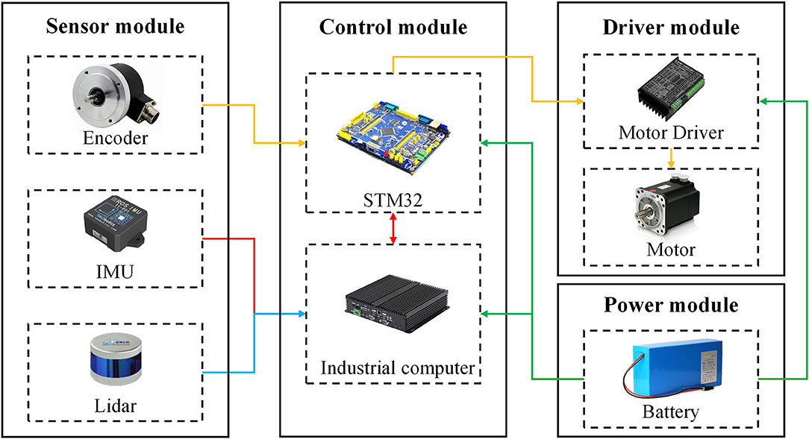
Background

Slide 27
Result
Reduced labor costs and increased profitability for farmers
Advancement of the agriculture sector
Sustainable food production was achieved
Potential of integrating AI and robotics in agriculture

Slide 28
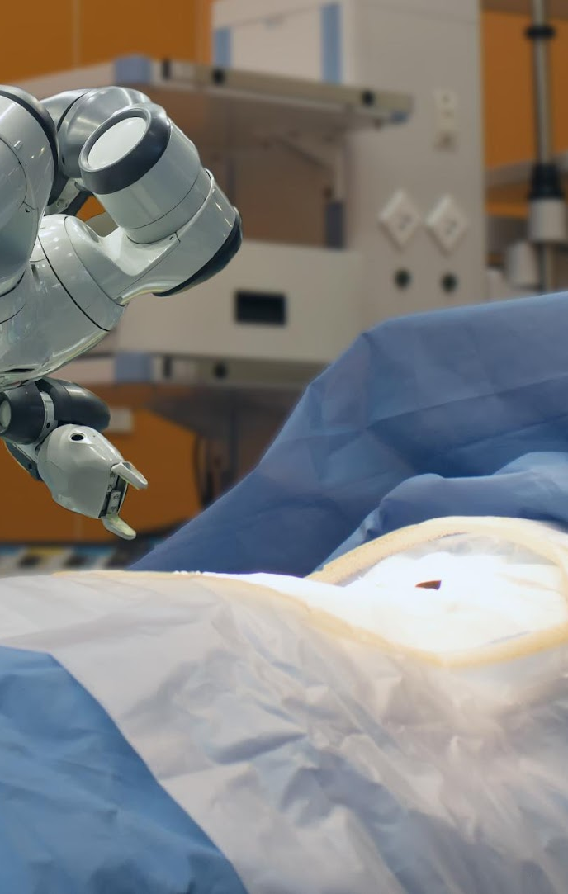
Conclusion
Innovative and exciting project
Potential to revolutionize the agriculture sector
Significant advancement in the Agriculture sector
Provide farmers with a reliable, efficient, and sustainable farming solution

Slide 29
References
Li, Y., Wu, J., Cao, Y., Li, L., & Li, X. (2021). An AI-enabled robotic system for home healthcare. Journal of Healthcare Engineering, 2021, 1-8.
Anwar, M. N., Al-Mamun, M. A., Akram, T., & Rahman, M. A. (2021). An AI-enabled robotic system for knee replacement surgery. Journal of Healthcare Engineering, 2021, 1-10.
Azimi, I., Jabari, H., Moini, A., Alimardani, M., & Shirinzadeh, B. (2020). Robotics and artificial intelligence in healthcare: A comprehensive review. Artificial Intelligence in Medicine, 102, 101759.

Slide 30

Thank you
NAME : HITENDRA SISODIA
SAP ID : 500091910
ROLL NO : R2142210352
BRANCH : CCVT NON HONS.

